Slide 1

Co-creating asset and place-based approaches to tackling refugee and migrant health exclusion Margaret Greenfields@aru.ac.uk

Slide 2
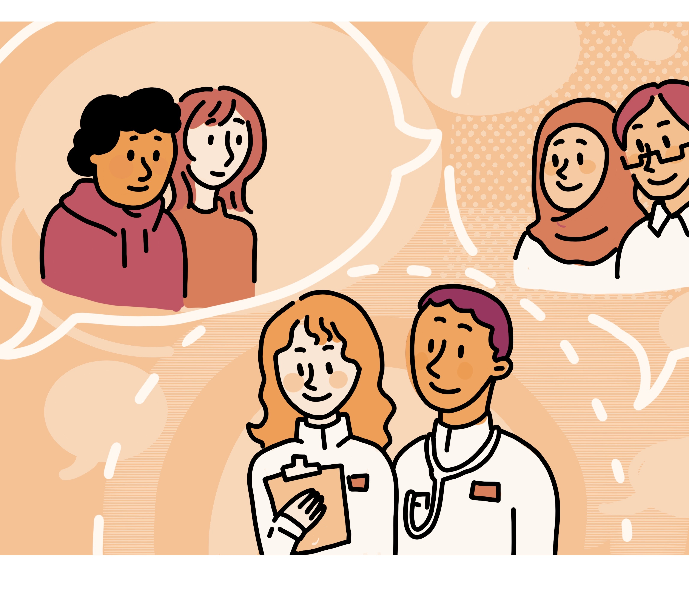
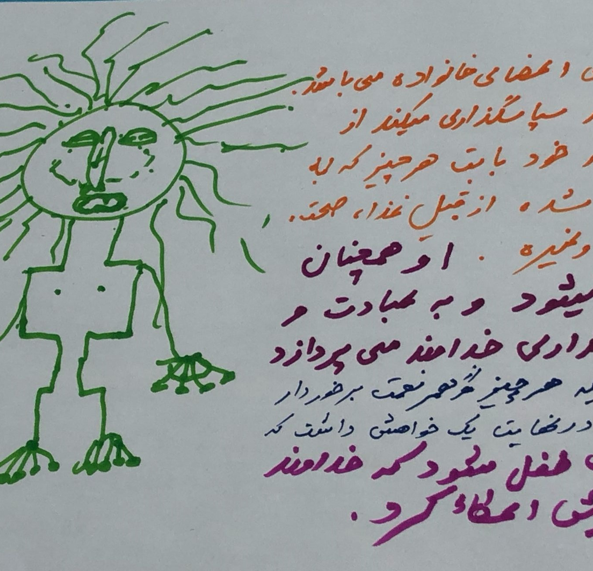
Project Goal
To make sure that community assets used by local communities are collaboratively identified and better supported to help improve the health outcomes for refugee, asylum-seeking and migrant communities.
Notes:
This research involves collaboration between 19 academic and community partners and a broad range of stakeholders from academia, policy professions, community development, health and social care, statutory and civil society agencies and creatives.
It has been designed to understand the experiences of Refugees, Asylum Seekers and Migrant communities’ in 12 localities in London and the East of England (including urban, rural and coastal areas) as they utilise and engage with a wide range of community assets (e.g. food banks, advice and health services, mosques and churches providing ESOL and social support, ‘green’ and ‘blue space’ etc). The aim is to explore how community assets can tackle health inequalities for the populations and identify transferable models of practice.

Slide 3
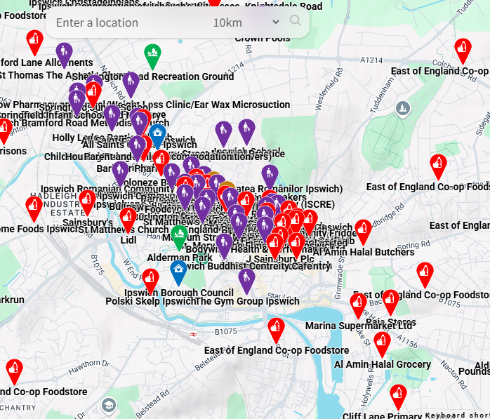
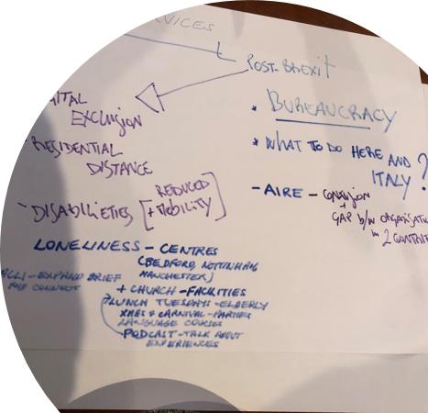
Progress so far
Up to June 2025:
Draft asset map ‘counter-cartography’ (all 12 sites)
Recruitment and training of 24 CCRs
80 walking interviews completed
CF1: launch events
CFs2 & 3: workshops - collecting data on the key topics with a range of nationalities
CF4: creative storytelling workshop on housing/home/belonging
Photographic community asset capture underway
June-December 2025:
CF5: stakeholder workshops
CF6-8: creative workshops
Notes:
Co-production and creative methodologies are embedded throughout the DNA of our study In order to capture participants’ experiences of service access and use, (and ultimately to generate an evidence-based conceptual framework for transdisciplinary interventions in health care that allow community assets to be efficiently integrated to support accessible, scalable services) in addition to traditional social science methods, we are incorporating digital counter-cartography; photographic methods; creative story telling and a range of other arts-based practices such as forum theatre; co-cooking and calligraphy, which are collaboratively identified by locality-based research teams, and vary across our 12 field-sites in urban, rural and coastal regions.

Slide 4
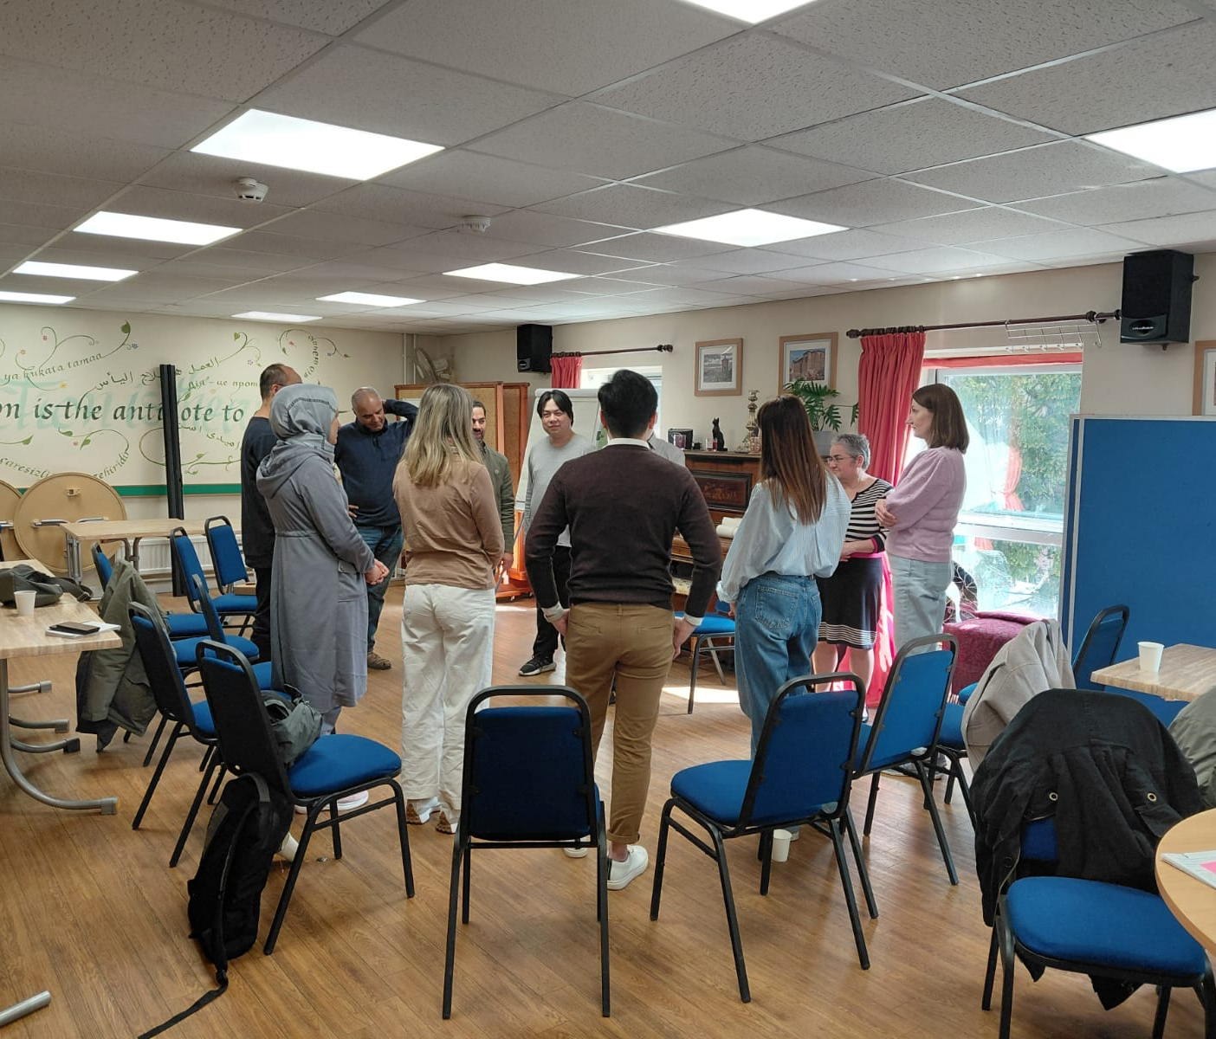

Challenges of Collaborative and of Creative Methods
Up to June 2025:
Multi-lingual events/documentation (16 core languages)
Recruitment of CCRs
Continuity of Engagement
Resourcing (across teams/time)
Reaching Consensus with so many moving parts
Ensuring adequate comparability given multiple methodologies and diverse populations
Power Dynamics across and within teams/civil society + academic balance
Plus…..
The current political climate
Notes:
Key challenges - translation – CCRs helping, extra reliance on them than expected. Comprehension of issues and context of responses. Selection of creative methods which are accessible to and favoured by all – nb – who selects? Translating creative outputs into meaningful data given breadth of participants.
Some excellent CCRs who are engaged in the project and some who struggled to complete interviews as thoroughly as hoped and are less engaged.
Some hard to reach nationalities, required specific CF events to meet. Different routes of entry create multiple perspectives to issues during CFs.
The next stage of data collection will need to address gaps identified in the initial analysis.
Gov’t changes to priorities re: research, migration and health creating uncertainty and stress in some field site areas in particular

Slide 5
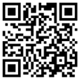
Thank you
www.migrefhealth.co.uk
#MigRefHealth

